Slide 1
Adaptations
Year 7 Science

Slide 2

Review
List 6 resources of a habitat that an organism needs to live.
For each of these, decide if they are biotic or abiotic:
a) predators
b) wind
c) competition for food
d) temperature
3. Explain the difference between an ecosystem and a habitat.

Slide 3
Learning Intentions
Interactions between organisms can be described in terms of food chains and food webs

Slide 4
Success criteria
Define adaptations as features that allow an organism to survive in its environment.
Give examples of adaptations of animals and plants.

Slide 5
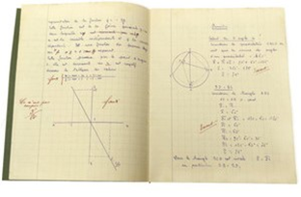
Adaptations
Adaptations are features that allow an organism to survive in its environment, such as
protecting themselves from predators,
surviving very hot, cold, windy or dry conditions
capturing light or food
moving around

Slide 6
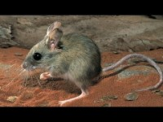
Write down as many adaptations as you can…

Slide 7
Activity 1: Design an organism

Slide 8
Success criteria
Define adaptations as features that allow an organism to survive in its environment.
Give examples of adaptations of animals and plants.

